Slide 1
Voice of the Dental Industry in Canada

Slide 2
ABOUT DIAC
The Dental Industry Association of Canada (DIAC) is a non-profit organization
Founded in 1978
Governed by an elected Board of Directors (volunteers)
Member companies provide products and services to the dental industry in Canada
Dental product manufacturers
Distributors of dental products
Dental Service/Support Organizations (DSOs) with >20 practices under management
Commercial laboratories
Professional service providers (HR, IT, legal, finance, etc.)

Slide 3
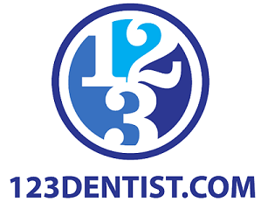
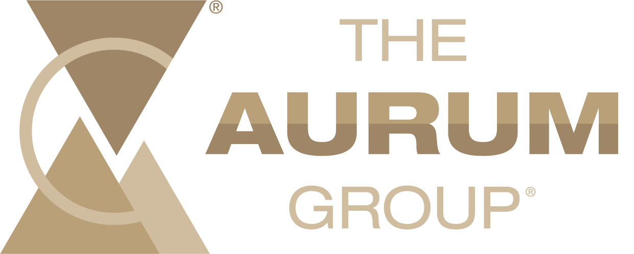
Board Members
16 volunteer board members representing the industry
Serve on committees including:
Membership Committee
Technorama & Conventions Committee
Regulatory & Industry Affairs Committee
Market Research & Data Committee
Finance Committee

Slide 4
VALUE OF MEMBERSHIP
Networking and business growth
Cultivate referral contacts and build relationships with distributors across the industry
Build company networks and grow business
Learn from speakers who know the industry and your business, meet members with relevant services, and connect with the right audience for your products and services

Slide 5
VALUE OF MEMBERSHIP CONT’D
Industry collaboration
Tap into industry insights, trends, and solutions through DIAC'S partnerships with key stakeholders (e.g., Canadian Dental Association Canadian Dental Hygienists Association, Dental Trade Alliance, etc.)
DIAC works closely with Medtech Canada on regulatory matters of mutual interest
DIAC advocates for our members with organizers of the major dental conferences in Canada (PDC, ODA, JDIQ)

Slide 6
VALUE OF MEMBERSHIP CONT’D
Market research and data
Get access to DIAC's proprietary research, the annual Future of Dentistry Survey report
Dentists across Canada are surveyed annually to ensure the industry is meeting the current and future needs of dental professionals.
Access to comprehensive industry data on product purchases, financing, and marketing

Slide 7
VALUE OF MEMBERSHIP CONT’D
Regulatory advocacy and education
Stay informed of new and changing regulations
Educate and consult with membership on legislative and procedural changes and provide industry feedback to Health Canada
Proactively engage with Federal and Provincial Governments on industry matters
Engage in learning opportunities with Health Canada

Slide 8
HOW DIAC INTERSECTS WITH THE FIELD OF DENTISTRY
Future of Dentistry Survey (FODS)
25 years of data
Survey provides one of the only comprehensive sources of dental market data in Canada
Dentists across Canada are surveyed annually to ensure the industry is meeting the current and future needs of dental professionals
Implemented in the Fall, results released in November only to Membership
Supported by sponsorship from Members

Slide 9
HOW DIAC INTERSECTS WITH THE FIELD OF DENTISTRY CONT’D
Hearing the voice of the customer in our strategic planning and membership activities through DSOs, who are members
Members represent more than 75% of exhibitors and sponsors supporting dental conferences throughout Canada, DIAC is onsite to support members
DIAC meets with major show managers annually to improve the experience for exhibitors and participants
Members sponsor education, workshops and training for dentists in product knowledge and professional development

Slide 10
HOW DIAC INTERSECTS WITH THE FIELD OF DENTISTRY CONT’D
Members of DIAC support research and development of dental practices and procedures
DIAC ensures that all members are in good standing and follow the Code of Conduct:
Members are licensed by Health Canada
Products are compliant
Increases professionals' confidence in the product and the safety of the patient
DIAC encourages membership from dental associations across Canada
Current members from dental association include:
Canadian Dental Association
Canadian Dental Hygienists Association
Denturists Association of Canada
Denturists Association of Ontario

Slide 11
Membership application is easy, visit www.diac.ca and complete the application

